Slide 1
CS 295B/CS 395B Systems for Knowledge Discovery
Courteous Goodwill:
A Case Study on Reproducible Research via Empirical Software Engineering

Slide 2
Themes for today
Scientific Integrity
Collegiality and Disagreement
Power dynamics

Slide 3
Content Warning
We will talk about reproducibility and professional communication today. One topic we will touch on resulted in a student suicide. I do not anticipate this dominating the discussion, but conversations may veer into other sensitive topics.
These topics may be distressing.
If you want to leave now, that is okay.
You can also leave if you just want the time back to study for midterms.
You do not owe me a reason for leaving class.

Slide 4
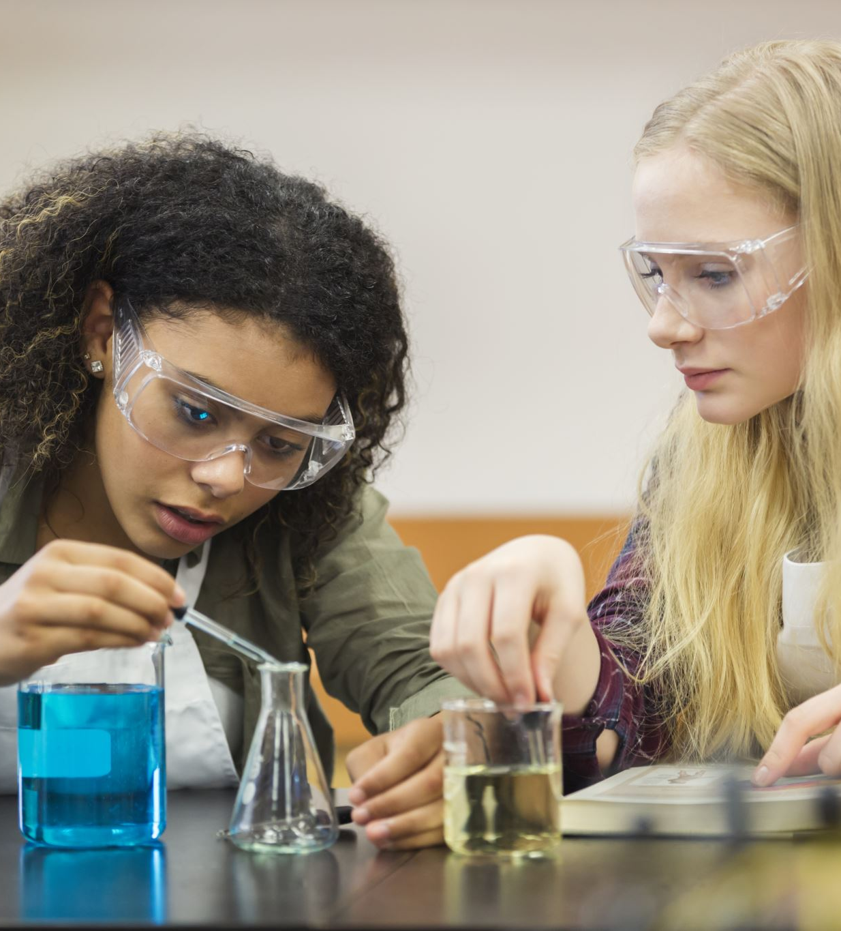
Why are we talking about these things?
Science is a collaborative, social process
Not just about findings!
Doing science is social
Sharing findings is social
Research methods aren’t just about how you investigate research questions
How we publicize and communicate
Norms: absorbed vs. taught

Slide 5
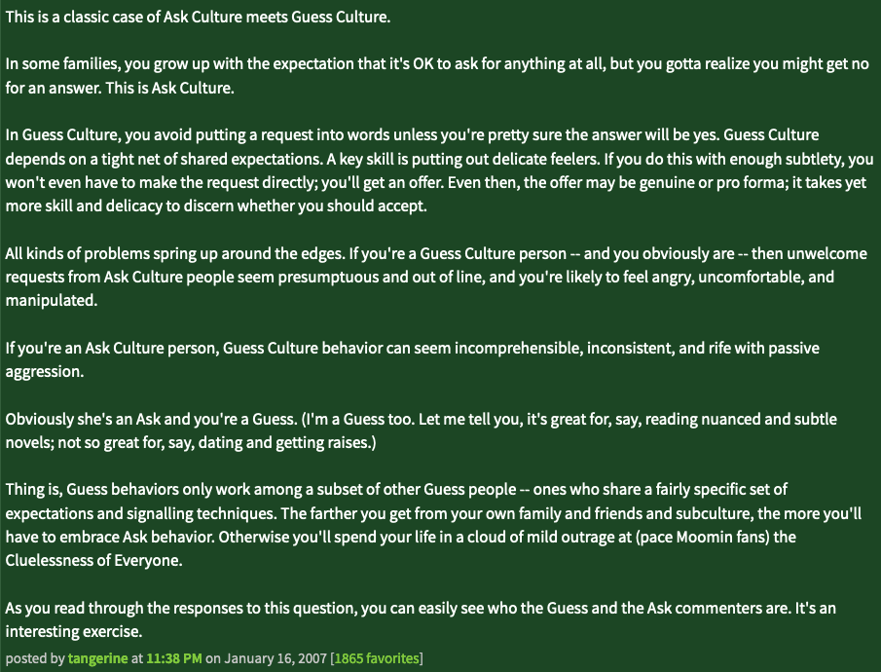
Ask vs. Guess culture
Famous post on Metafilter
Scenario: Not-close childhood friend asks to stay at your place after being denied before. Is this unforgivably rude?
What does this have to do with science and reproducibility?

Slide 6
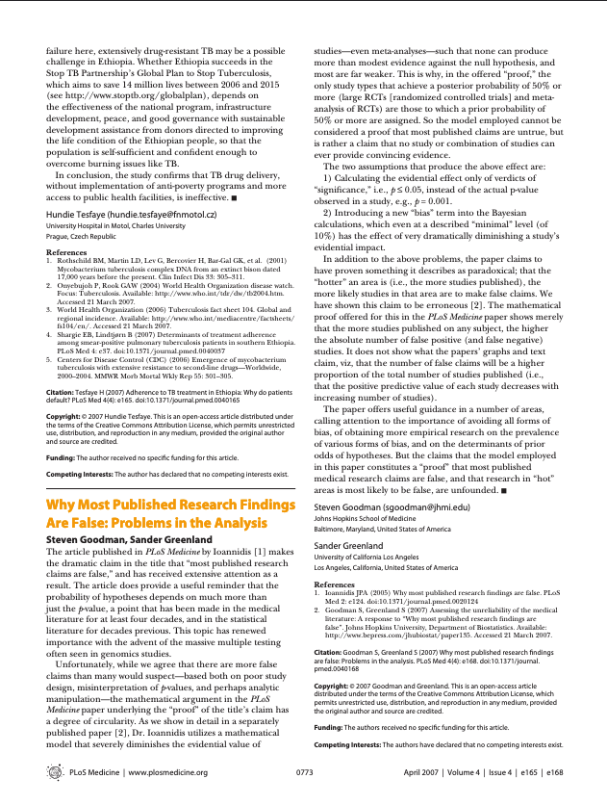
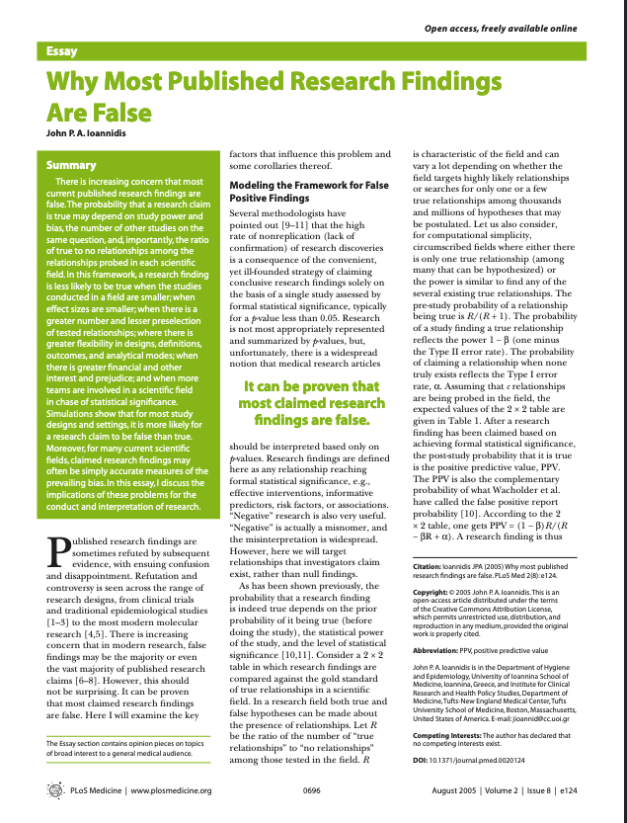
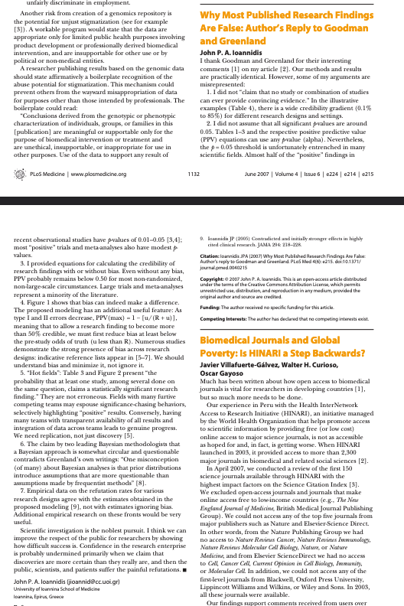
What is reproducibility and how did we come to care?

Slide 7
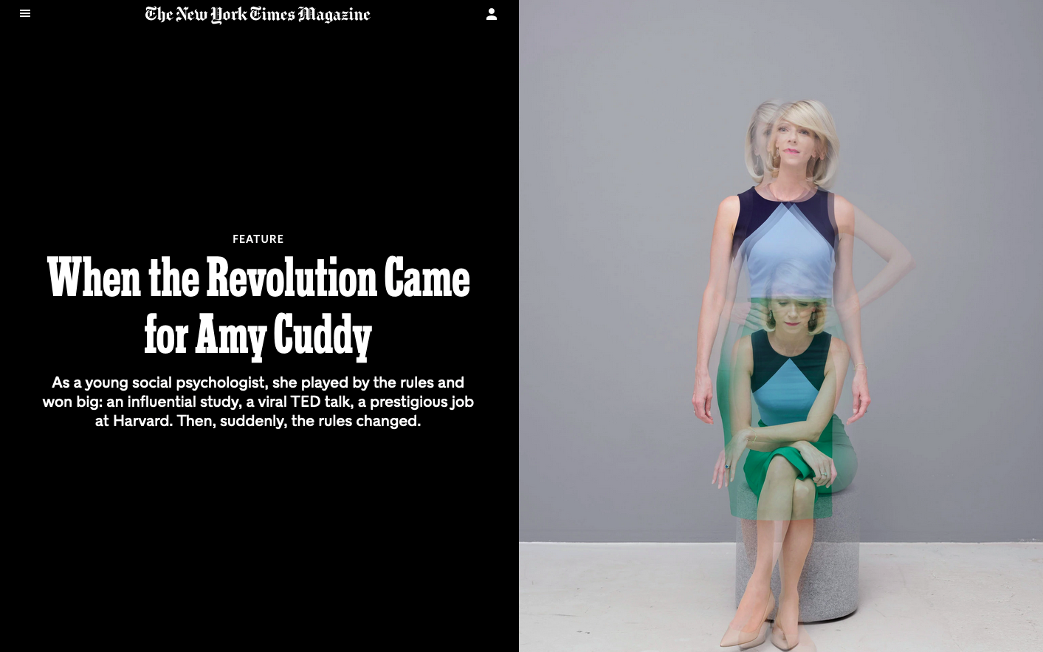

Slide 8
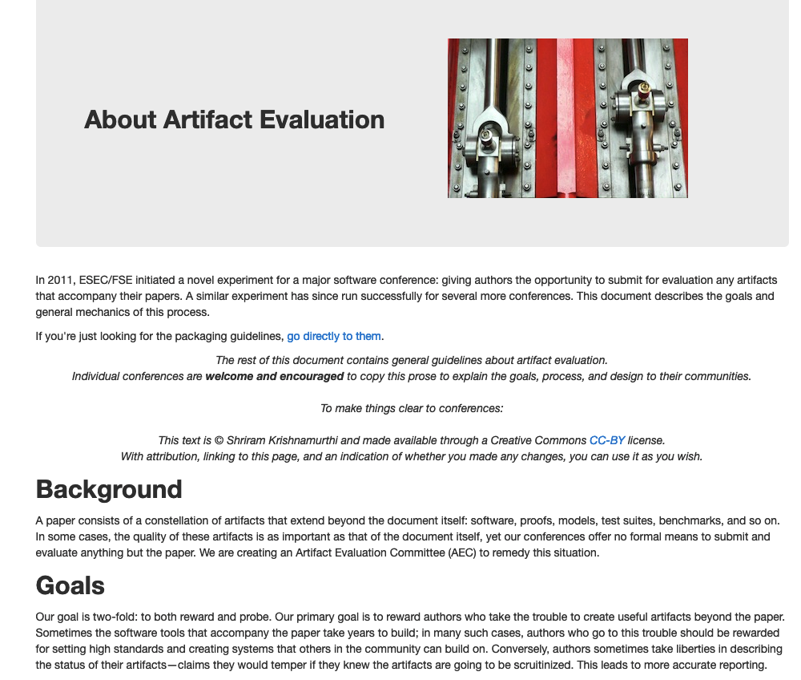
https://artifact-eval.org/about.html

Slide 9
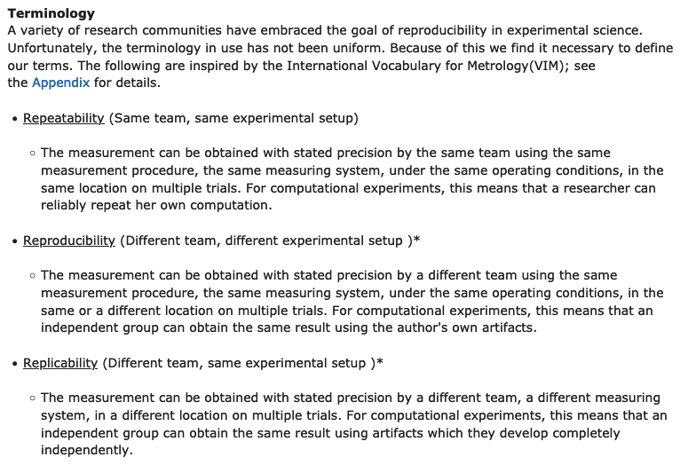
ACM definitions

Slide 10

How are these related to the other topics
What happens if the reproduction shows that the findings don’t hold?
Need to be sensitive:
Today: Work == brand == identity
We are both scientists and marketers

Slide 11
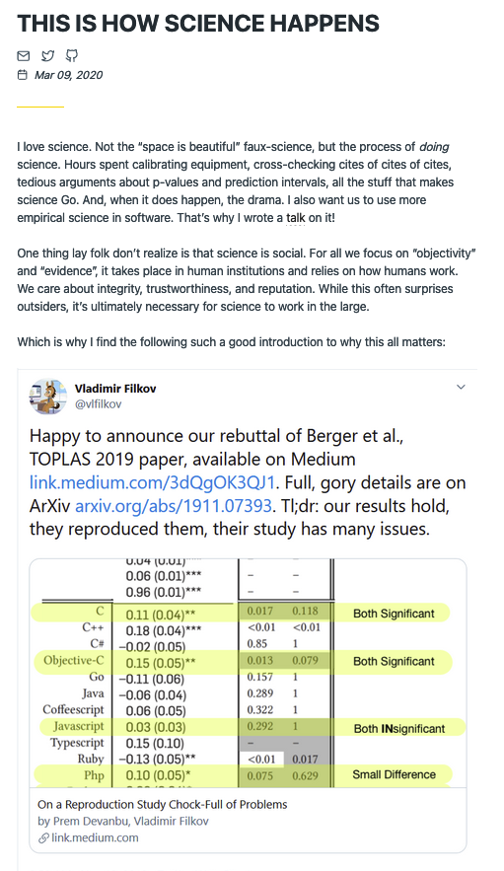
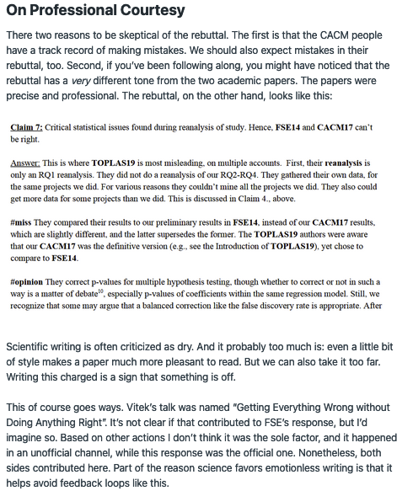
Friday readings: reproducibility
Broad community consensus: reproducibility is good
Verifying findings is important!
Discussion is important!
Hillel Wayne essay – discourse on Twitter, not in letters!
How you handle the discussion is also important

Slide 12
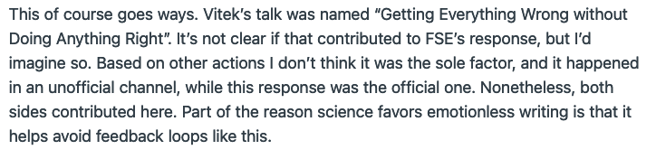
Friday readings: reproducibility
Broad community consensus: reproducibility is good
Verifying findings is important!
Discussion is important!
Hillel Wayne essay – discourse on Twitter, not in letters!
How you handle the discussion is also important

Slide 13
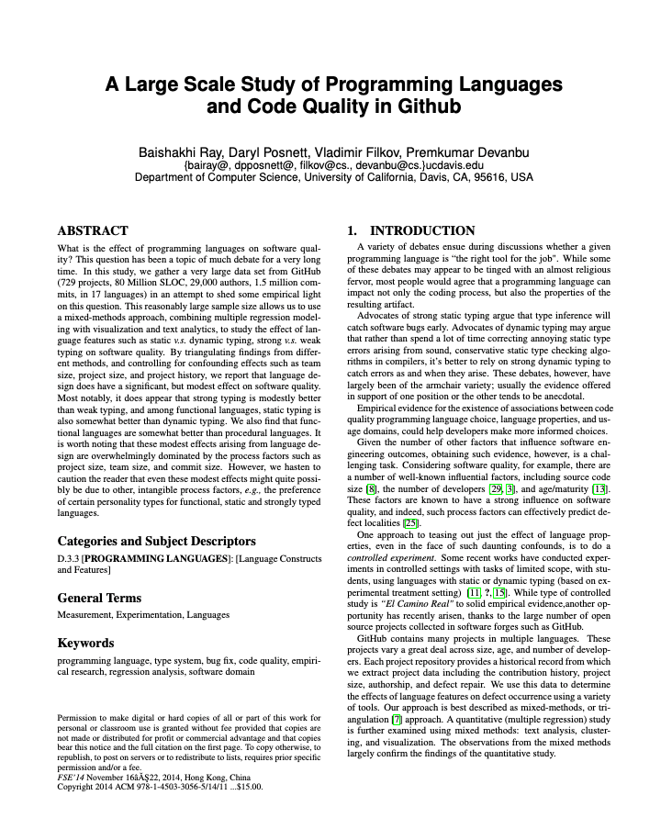
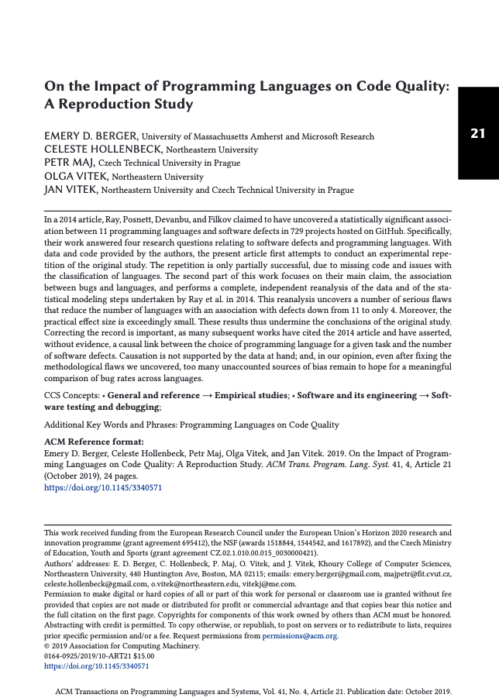
Power dynamics of parties involved
NOT saying bad to criticize.
Don’t look as an individual problem.
Discussion:
What do we owe the community in our public criticisms?
Original paper
First author: Female grad student/Jr. faculty
Reproduction
First author: very senior male scholar

Slide 14
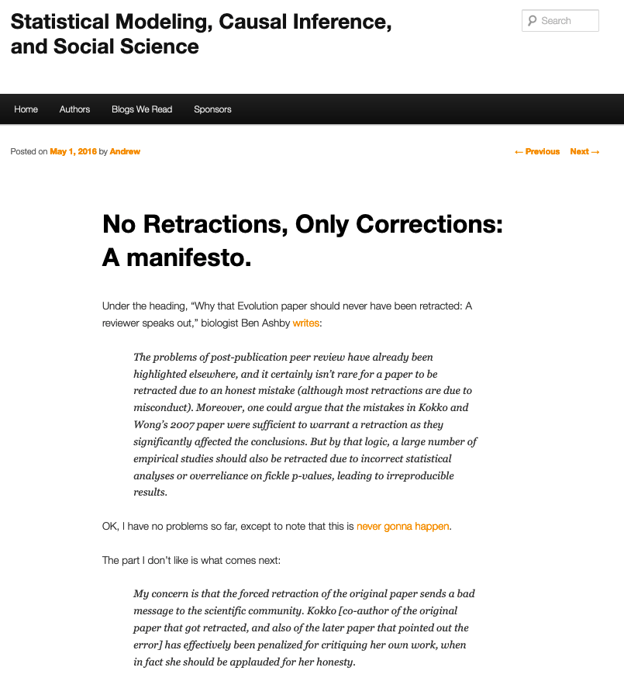
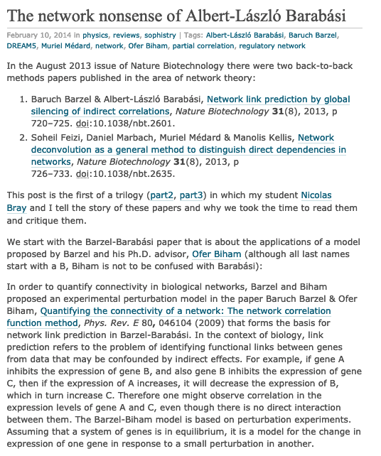
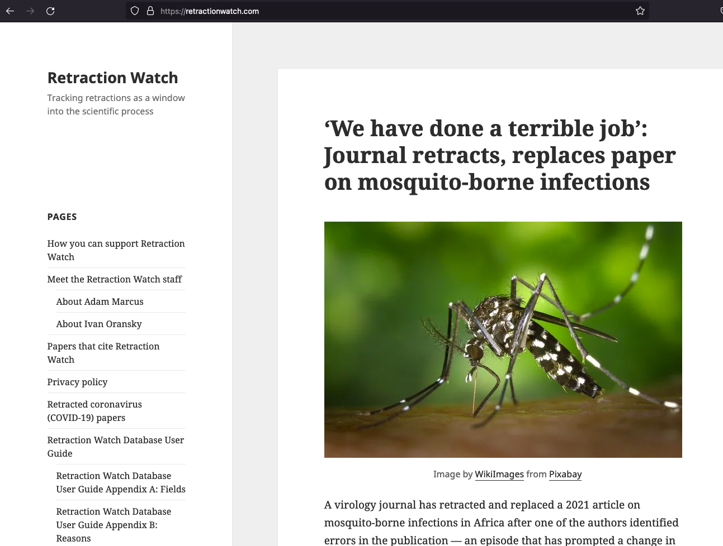
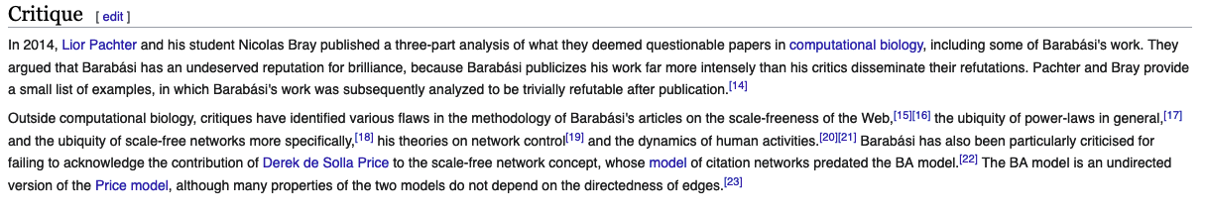
Bad Behavior & Proposed Resolutions

Slide 15
History of disagreement in CS

Slide 16
Flame Wars in CS

Slide 17
Discussion time: Less famous, common scenarios
Some actual scenarios (some very common):
Graduate student feels their work was stolen or they were boxed out
Graduate student asked to add an author with dubious contributions
Graduate student finds an error in collaborator’s work
Graduate student has a scientific disagreement with their advisor
Graduate student asked to fabricate results

Slide 18
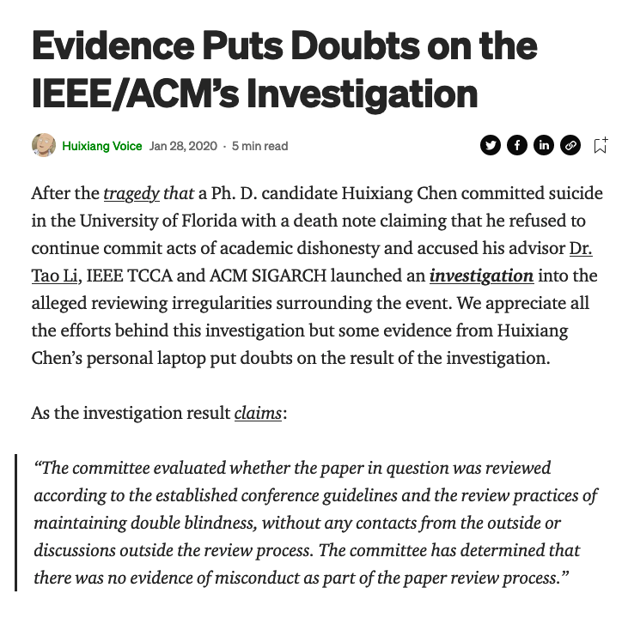
Fabricating results
Unequivocally problematic
Not common, but stakes are very high

Slide 19

Fabricating results: What to do?
Establish outside mentors early in your career
Get help and perspective
Mentor may ask: what makes you say this? Make sure you have evidence and are sure that it’s a fabrication. Be open to having the wrong read.

Slide 20
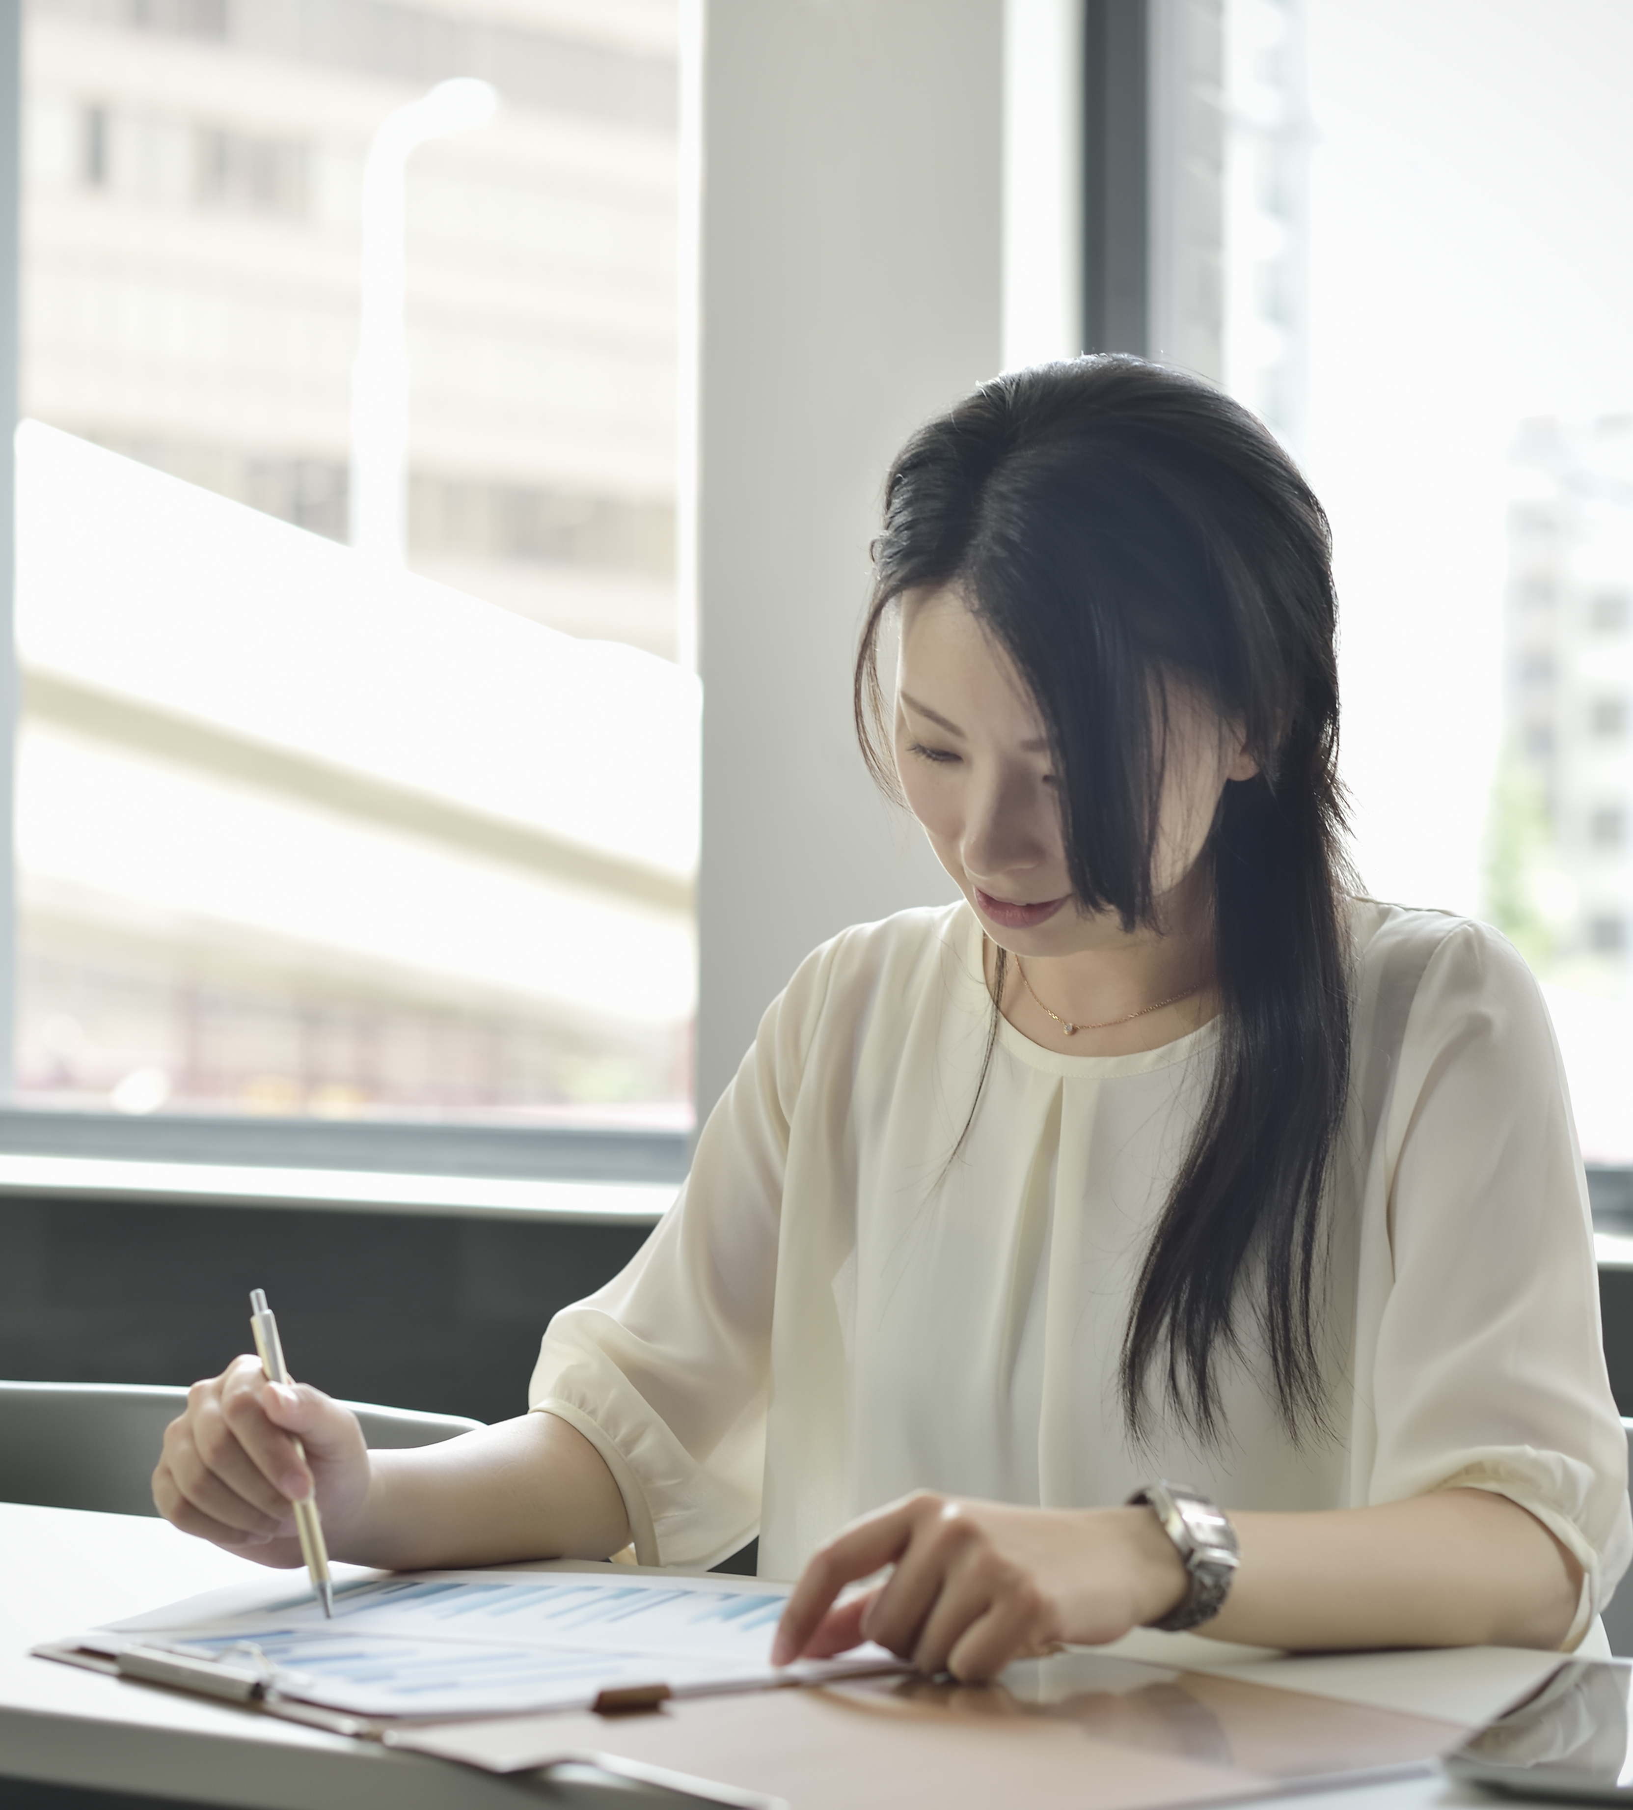
Fabricating results: What to do?
Document exchanges
“Feeling pressured” is vague; feelings are valid but not actionable
Get requests in writing and have hard evidence
Write up summaries after the fact and circulate
Know your rights (e.g., are you in a 2-party consent state? Can you bring a non-compromised collaborator to meetings as a witness?)

Slide 21
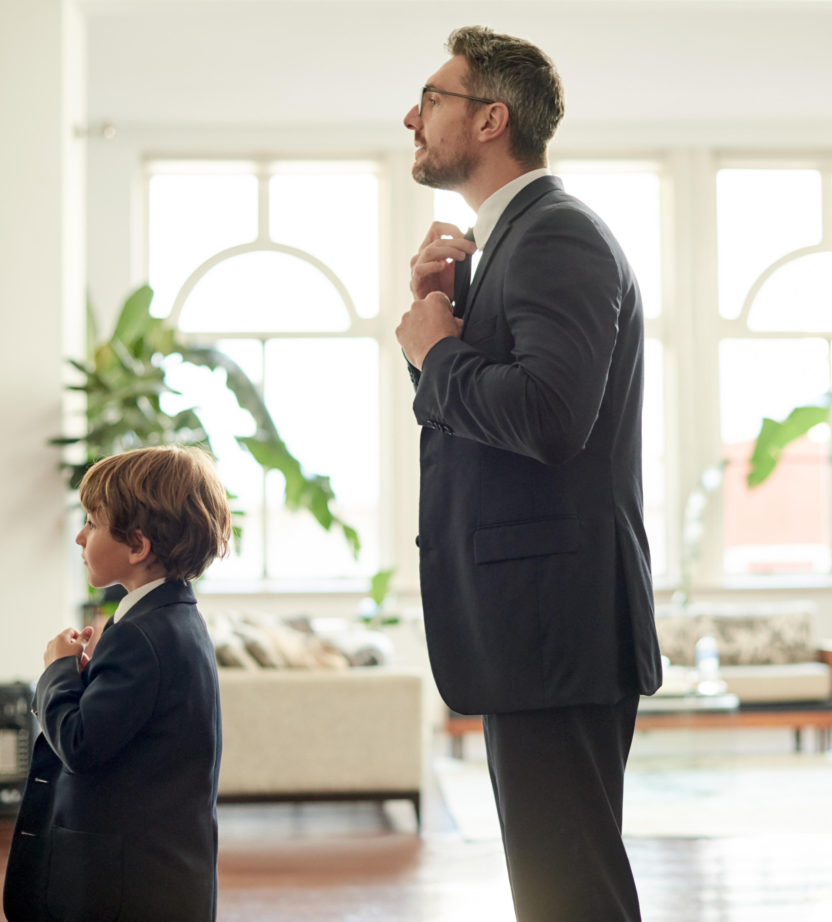
Scientific disagreement
This is normal the more senior you become
Goal of advisors:
train the student to become a peer
What is the nature of the disagreement?
Natural to feel awkward as you transition to a more independent role

Slide 22
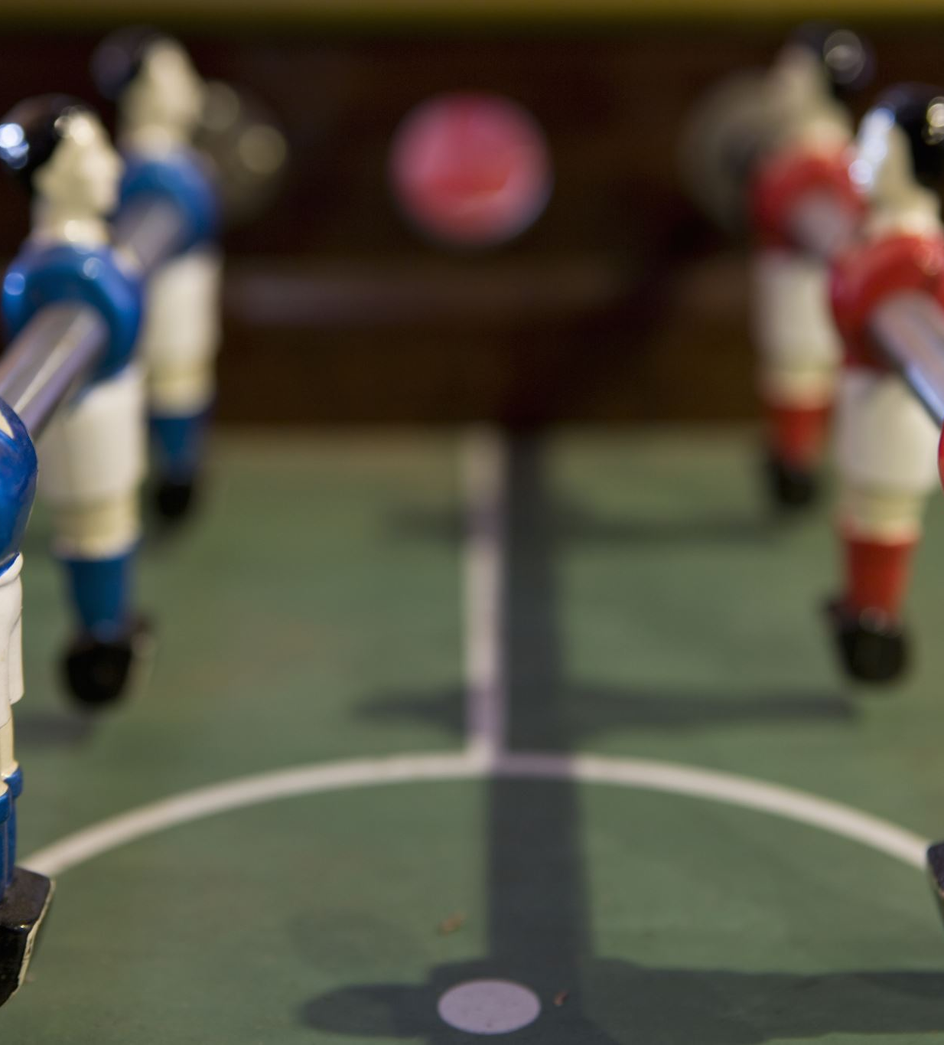
Scientific disagreement: What to do?
Malpractice/bad behavior not taken lightly
Try to understand why your advisor might disagree:
Are they familiar with the methods? Perhaps they feel they cannot advise you on this and don’t know how to say that?
Do they understand the problem? Be assertive! You are becoming the expert!
Talk to your mentors and collaborators; practice being heard.

Slide 23
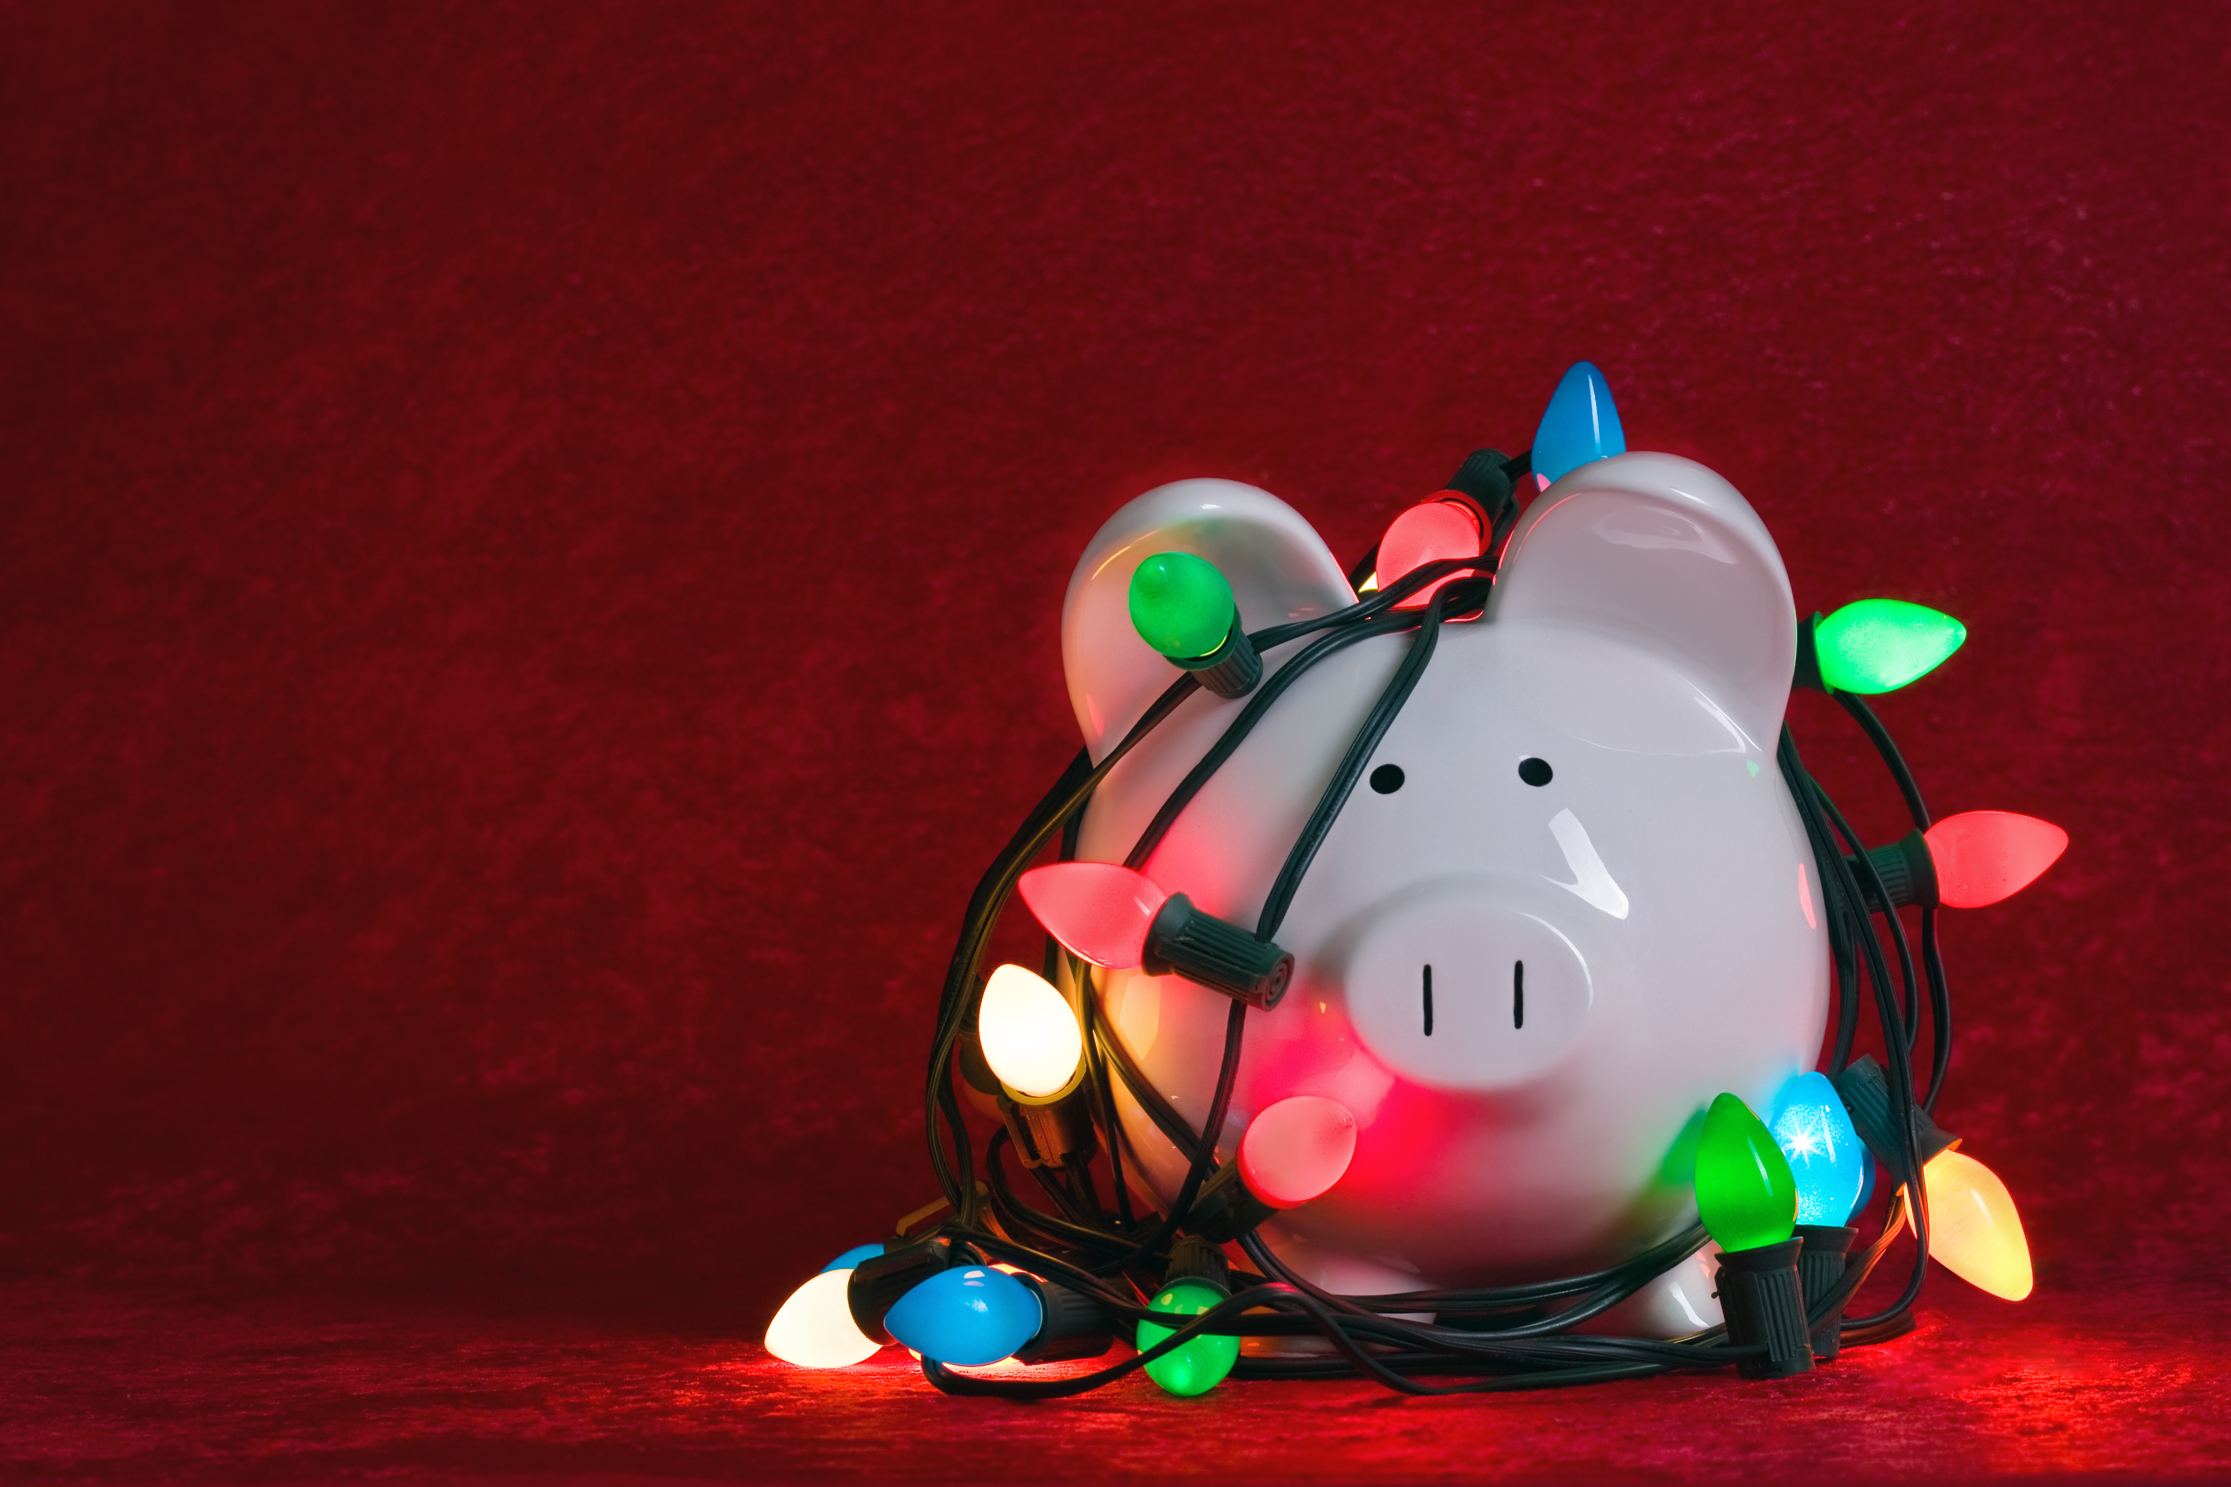
Error in collaborator’s work
Researchers are not infallible
People make mistakes
Peer review is imperfect
Unhealthy to hold researchers to impossible standards
People are sensitive to criticism when it’s tied to their integrity and sense of self (most researchers)
This is fundamentally unscientific, but a reality

Slide 24
Error in collaborator’s work: What to do?
Perfect world: always talk it over with your advisor!
We live in an imperfect world, so…
If the collaborator is not your advisor, then talk to your advisor
Your advisor may know the person better, know how to approach (if appropriate)
If the collaborator is your advisor, then talk to your outside mentor
Does the error cast doubt on the integrity of the work?

Slide 25
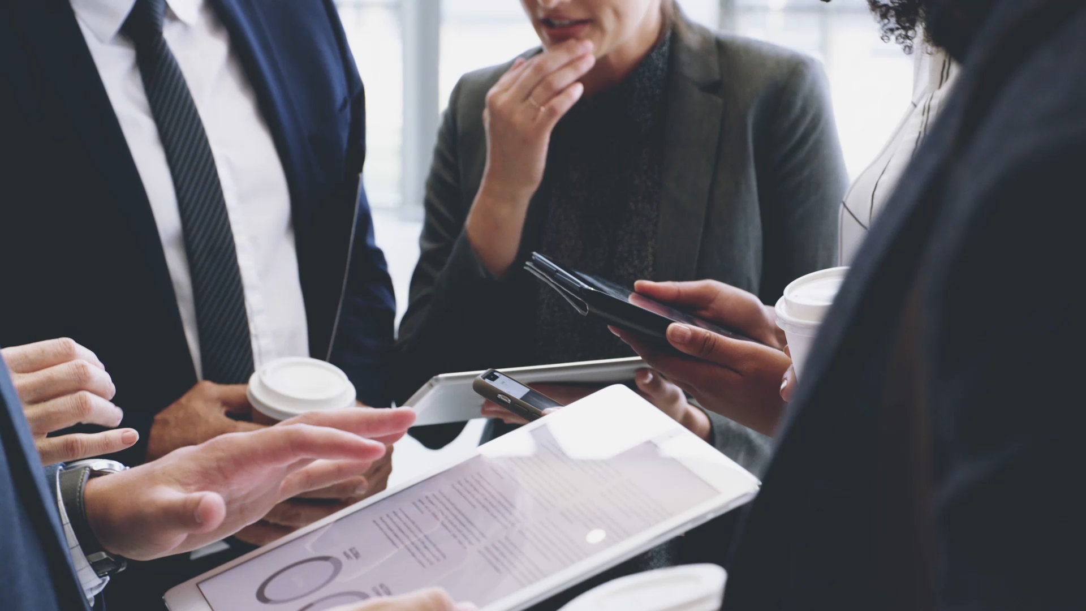
Dubious contributions of coauthors
Authorship disputes: extremely common
Authorship is discipline-specific
Advisors should discuss what constitutes authorship early and often (e.g. ACM guidelines)
“Invisible” contributions
High-level discourse (in every meeting)
Backchannel conversations

Slide 26
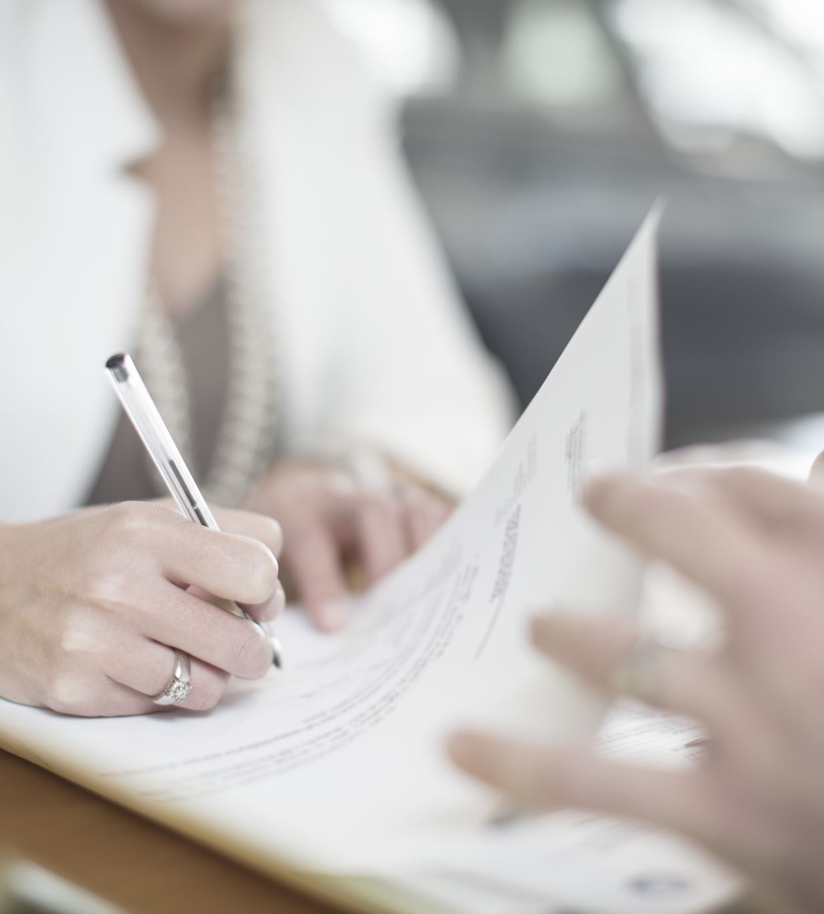
Dubious contributions of coauthors: What to do?
Where do you fall on the author list?
What contributions does that person believe they have made?
Everyone should be able to articulate what they contributed to a publication
DO NOT accuse that person of not making contributions
Can think of authorship as contract…
and can go both ways

Slide 27
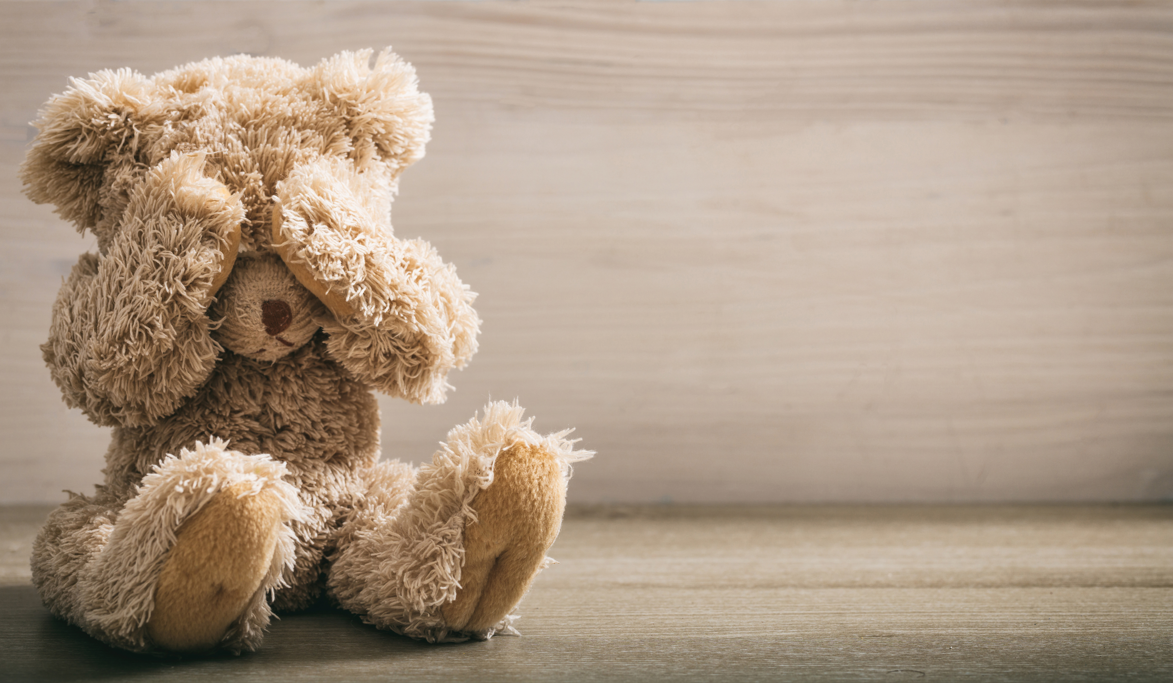
Stolen work/boxed out
EXTREMELY common sentiment
Contemporaneous discovery
Truly stolen work far less common than feeling/being boxed out
Stolen work hard to prove
Boxed out == social phenomena

Slide 28
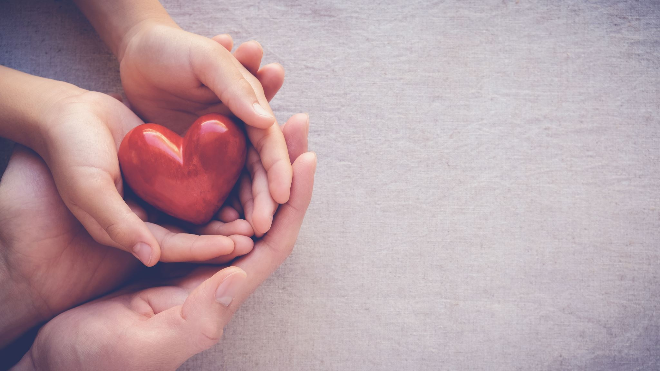
Stolen work/boxed out: What to do?
BE GENEROUS with others
Instinct will be to be defensive.
Better to trust but verify.
BE GENEROUS with yourself
You have many good ideas.
Sharing your ideas as audition: how do people treat you? Would you work with them in the future?
Antidote is for you to publicize your work and be generous with credit!

Slide 29
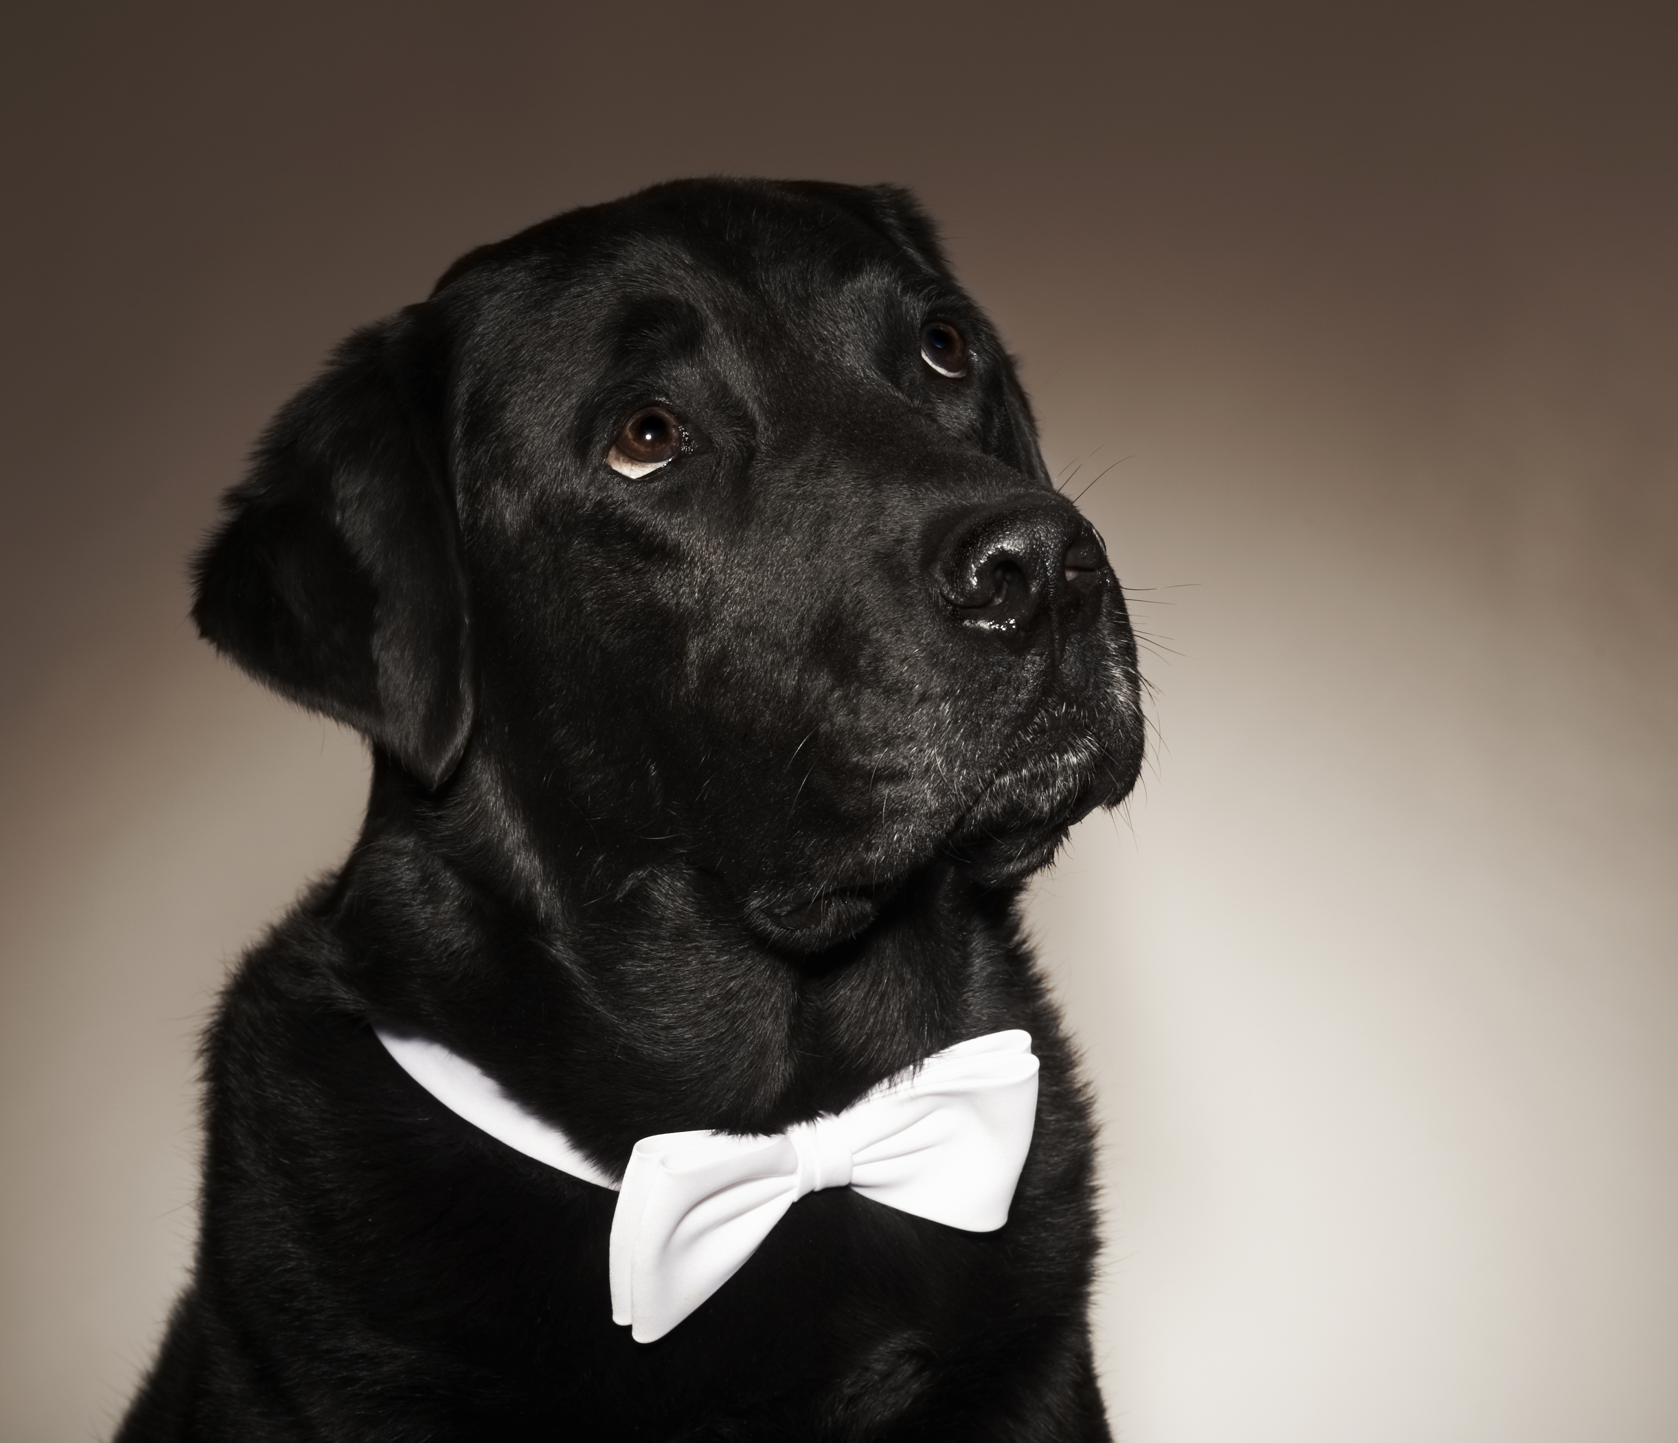
What does this have to do with reproducibility?
Theme: Trust
Trusting positive intent of authors
(they want to do good science!)
BUT feel free to be skeptical of results
(this is scientific!)
Reproducibility as a social process
As a conversation
Focus on the big ideas

